Slide 1



Dashboard Sales
View in Power BI
Last data refresh:
2/17/2024 4:51:18 PM UTC
Downloaded at:
2/17/2024 4:52:57 PM UTC

Slide 2
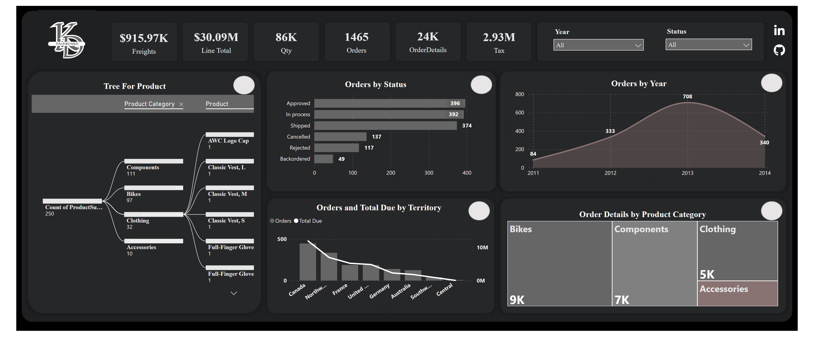
Dashboard Sales
Notes:
card
No alt text provided
card
No alt text provided
card
No alt text provided
card
No alt text provided
card
No alt text provided
card
No alt text provided
areaChart
No alt text provided
clusteredBarChart
No alt text provided
slicer
No alt text provided
slicer
No alt text provided
lineStackedColumnComboChart
No alt text provided
Order Details by Product Category
No alt text provided
decompositionTreeVisual
No alt text provided
textbox
No alt text provided
image
No alt text provided
image
No alt text provided
image
No alt text provided

